Slide 1
Linear Regression
By Dr. Supriya Chakraborty
Amity Institute of Information Technology Kolkata

Slide 2
Regression
The data is continuous.
Many models could be used –Simplest is linear regression
Fit data with the best hyper-plane which "goes through" the points

Slide 3
Which is best by Example?

Slide 4
Types of Regression Model
Regression Models
Simple
Linear
Non-Linear
Multiple
Linear
Non-Linear
2+ Feature
1 Feature

Slide 5
Linear Regression
Given an input x compute the output y
For Example
Predict height from age
Predict price of house from area
Predict distance from wall to sensors

Slide 6
Understanding the linear Equation

Slide 7
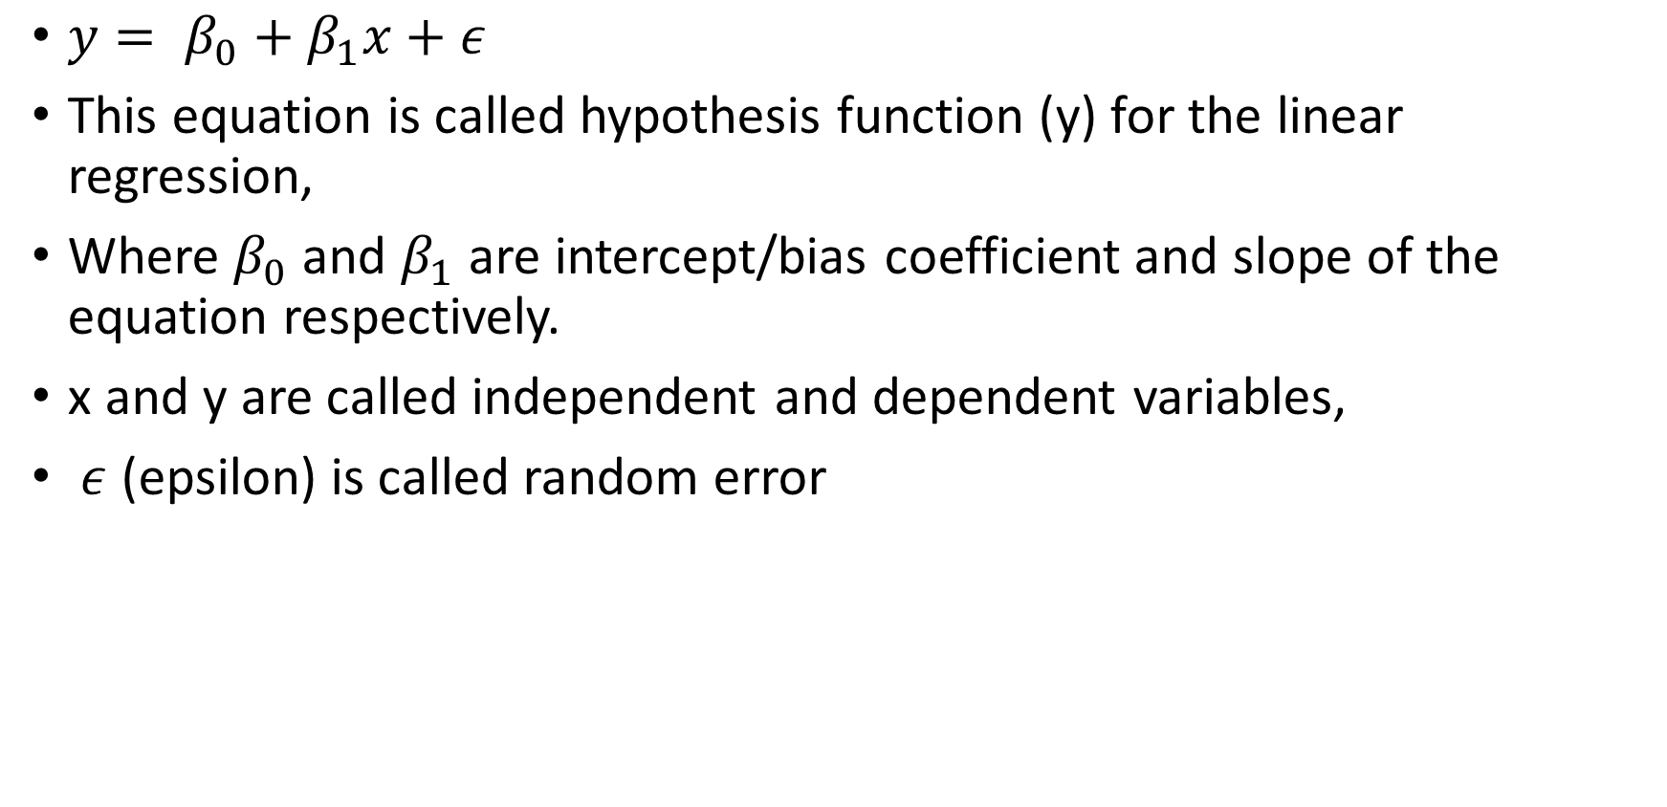
Simple Linear Regression Model
$y= β_{0}+β_{1}x+ε$
This equation is called hypothesis function (y) for the linear regression,
Where $β_{0}$ and $β_{1}$ are intercept/bias coefficient and slope of the equation respectively.
x and y are called independent and dependent variables,
$ε$ (epsilon) is called random error

Slide 8
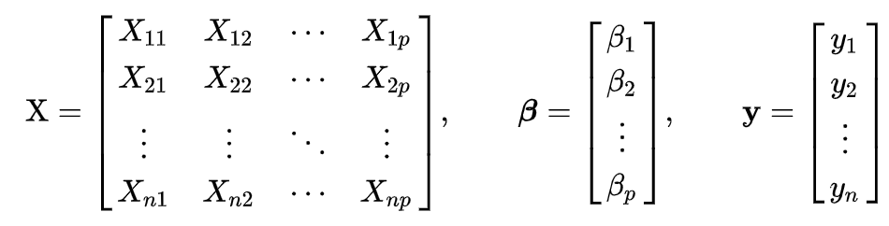
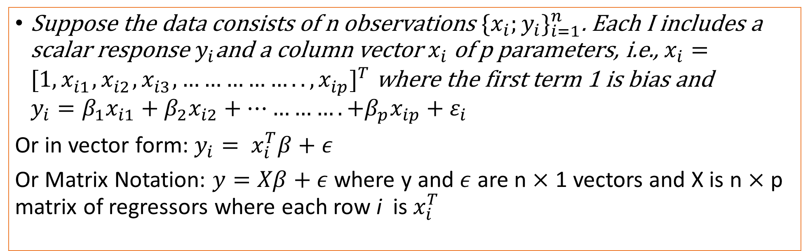
Multiple Linear Regression Model
Suppose the data consists of n observations ${\{x_{i};y_{i}\}}_{i=1}^{n}$. Each I includes a scalar response $y_{i}$and a column vector $x_{i}$ of p parameters, i.e., $x_{i}={[{1,x}_{i1}^{},x_{i2}^{},x_{i3}^{},……………..,x_{ip}^{}]}^{T}$ where the first term 1 is bias and $y_{i}=β_{1}x_{i1}+β_{2}x_{i2}+………….+β_{p}x_{ip}+ε_{i}$
Or in vector form: $y_{i}= x_{i}^{T}β+ε$
Or Matrix Notation: $y=Xβ+ε$ where y and $ε$ are n $×$ 1 vectors and X is n $×$ p matrix of regressors where each row i is $x_{i}^{T}$
Click to move the slide Solution not Possible
Source: https://en.wikipedia.org/wiki/Ordinary_least_squares

Slide 9
Linear Regression Learning the Models
Learning a linear regression model means estimating the values of the coefficients used in the representation with the data that we have available.
There are many more techniques:
Slope-Intercept technique
Ordinary Least Squares
Gradient Descent

Slide 10
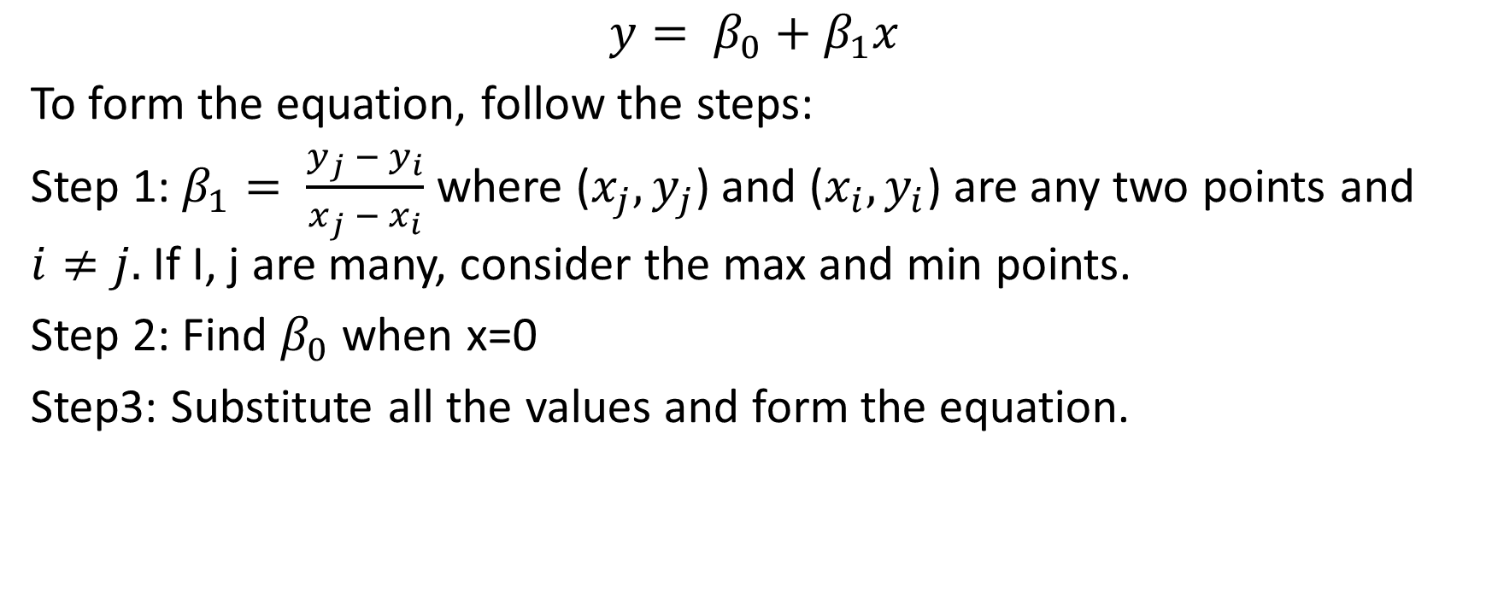
Slope-Intercept Technique
$$y= β_{0}+β_{1}x$$
To form the equation, follow the steps:
Step 1: $β_{1}= \frac{y_{j} − y_{i}}{x_{j} − x_{i}}$ where ($x_{j},y_{j}$) and ($x_{i},y_{i}$) are any two points and $i≠j.$ If I, j are many, consider the max and min points.
Step 2: Find $β_{0}$ when x=0
Step3: Substitute all the values and form the equation.

Slide 11
Example Data of Sales Price and Area
House Number | Y: Actual Selling Price | X: House Size (100s ft2)
1 | 89.5 | 20.0
2 | 79.9 | 14.8
3 | 83.1 | 20.5
4 | 56.9 | 12.5
5 | 66.6 | 18.0
6 | 82.5 | 14.3
7 | 128.3 | 27.5
8 | 79.3 | 16.5
9 | 119.9 | 24.3
10 | 87.6 | 20.2
11 | 112.6 | 22.0
12 | 120.8 | .019
13 | 78.5 | 12.3
13 | 74.3 | 14.0
15 | 74.8 | 16.7
Average | 88.84 | 18.7

Slide 12
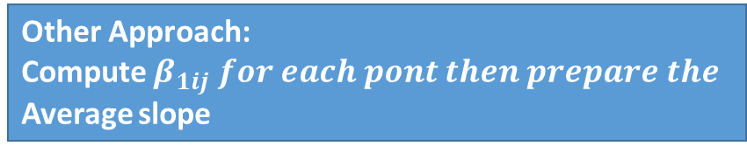
Plot the Data of Sales Price and Area of House
Fit the line of Slope-Intercept form
Other Approach:
Compute $β_{1ij} for each pont then prepare the$
Average slope

Slide 13
Fit the line: Ordinary/Least Square Method
Geometrically, this is seen as the sum of the squared distances, parallel to the axis of the dependent variable, between each data point in the set and the corresponding point on the regression surface—the smaller the differences, the better the model fits the data.

Slide 14
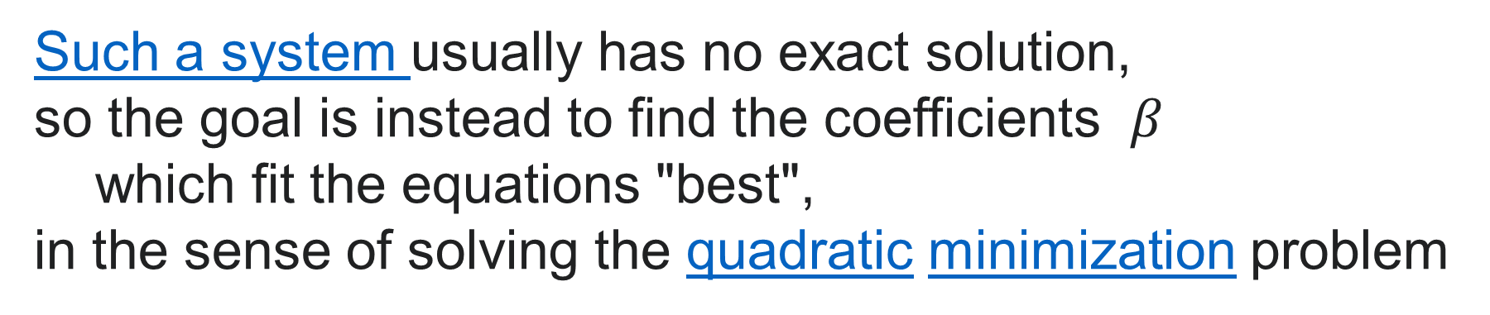
Such a system usually has no exact solution,
so the goal is instead to find the coefficients $β$
which fit the equations "best",
in the sense of solving the quadratic minimization problem

Slide 15

For Simple Linear regression Model : contains only two variables, one constant value
$$y= β_{0}+β_{1}x+ε$$
$$\hat{β_{1}}=\frac{n \sum{x_{i}y_{i} −n\sum{x_{i}\sum{y_{i}}}}}{n\sum{x_{i}^{2}} −{(\sum{x_{i}})}^{2}}$$
$\hat{β_{0}}=\overline{y} − \hat{β_{1}}x$
Where $\overline{y}$ is the mean

Slide 16
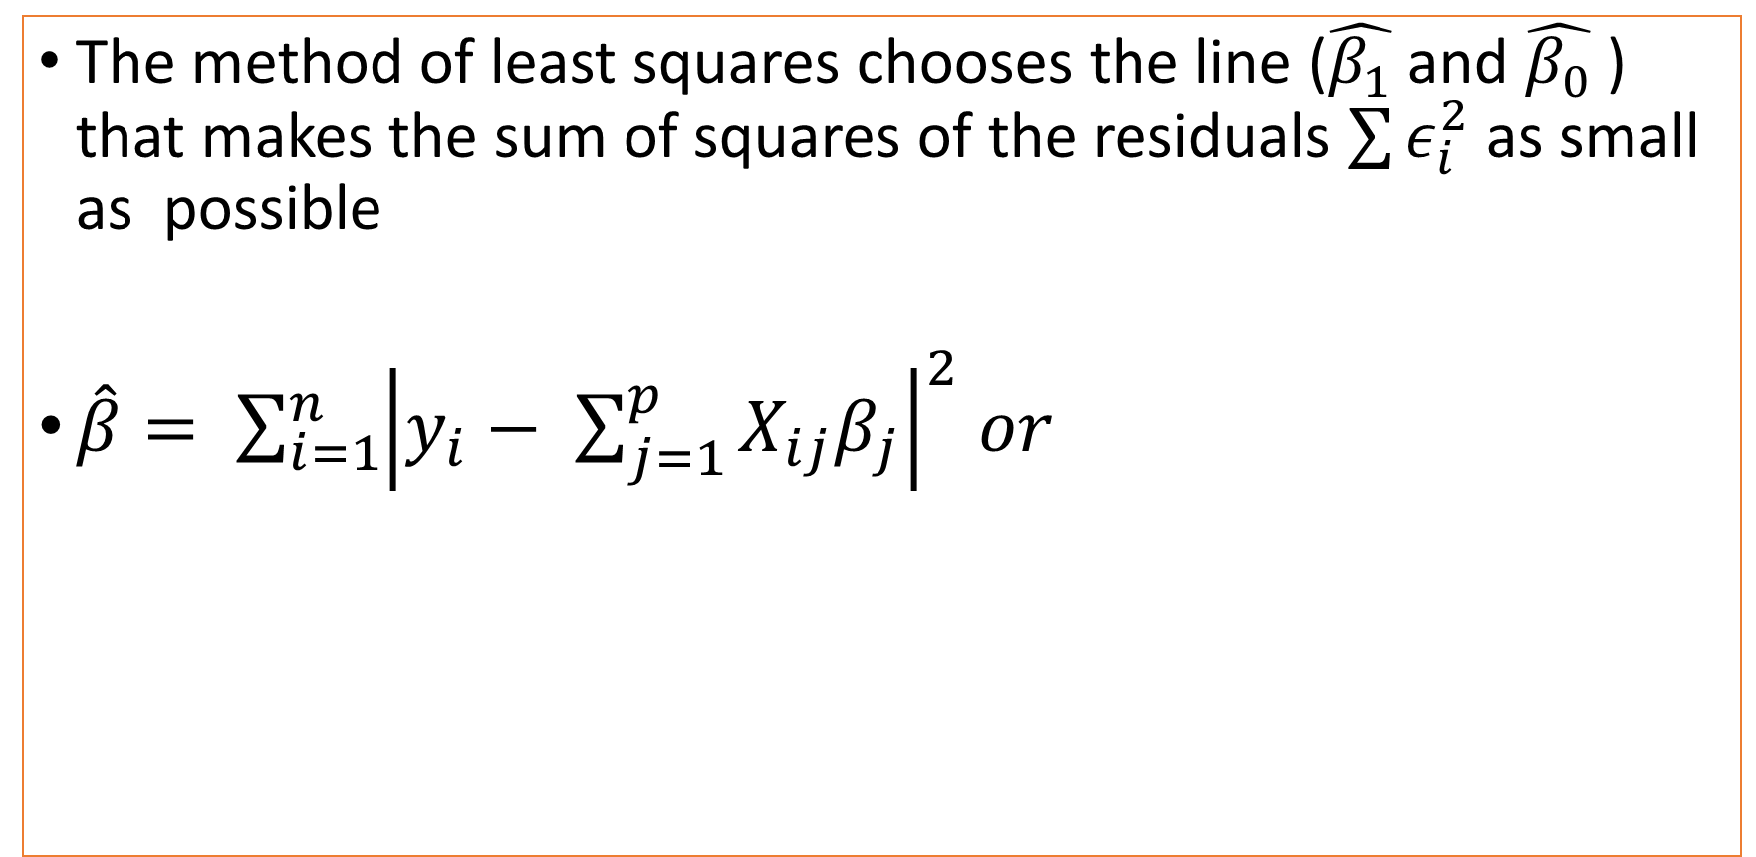
For Multiple Linear regression Model: contains more than two variables
The method of least squares chooses the line ($\hat{β_{1}}$and $\hat{β_{0}}$ ) that makes the sum of squares of the residuals $\sum{ε_{i}^{2}}$ as small as possible
$\hat{β}= \sum_{i=1}^{n}{{\left|y_{i}− \sum_{j=1}^{p}{X_{ij}β_{j}}\right|}^{2} or }$

Slide 17
Assumption on Linear regression
Linearity: means that dependent variable has a linear relationship with independent variables.
Normality: means that the observation errors are normally distributed.
Independency: means that the observation errors are independent of each other.
Homoscedasticity: means that the observation errors are not a function of the response variable and their variance is constant for all observations.
Low multi-collinearity: means that the independent variables are not highly correlated to each other.
Notes:
In many cases with real data, it would be difficult to satisfy all these assumptions. This does not necessarily mean you cannot use linear regression. However, if any of these assumptions is not met, the optimal performance cannot be expected and the inference of the model coefficients could be inaccurate. In this article, our focus is on the assumption 4.

Slide 18
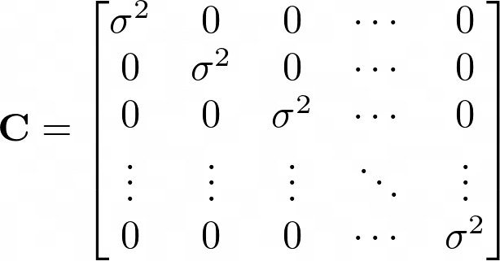
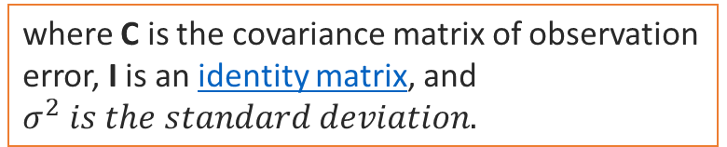
Homoscedasticity
Linear regression assumes that observation errors inside e are independent and identically distributed (i.i.d) normal random variables (assumptions 2, 3, and 4). This condition can be shown mathematically as
where C is the covariance matrix of observation error, I is an identity matrix, and $σ^{2} is the standard deviation.$
Notes:
Explanation of the Matrix Data
Diagonal elements of the covariance matrix represent the variance of each observation error and they are all the same because the errors are identically distributed. The off-diagonal elements represent the covariance between two observation error and they are all zero because the errors are statistically independent. This condition is referred to as homoscedasticity.

Slide 19
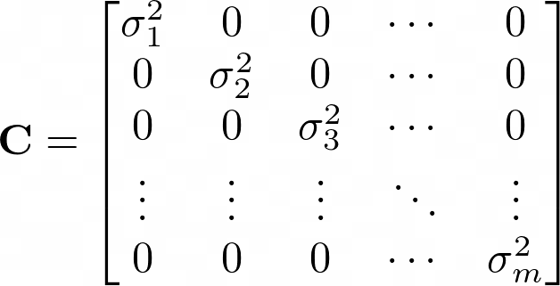
Heteroscedasticity
Observation errors are in fact not identically distributed (although we still assume they are independent). In this case, the covariance matrix of observation errors is represented as
Notes:
Explanation of the Matrix Element
where the diagonal elements are not identical and each observation has its own variance. Lack of homoscedasticity has several consequences on linear regression results. First, the performance of the models is no longer optimal. In other words, the model will not have the lowest mean square error (MSE). Second, model coefficients and standard errors will be inaccurate and hence their inferences and any hypothesis testing based on them will be invalid.

Slide 20
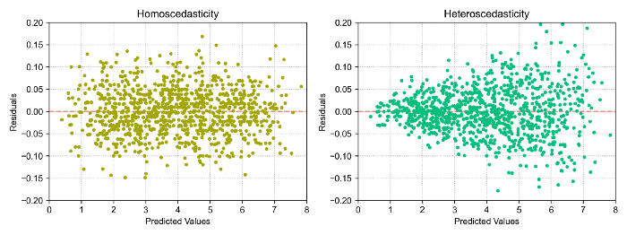
Detection of Homoscedasticity and Heteroscedasticity
Notes:
There are many ways to detect if you are dealing with heteroscedastic or homoscedastic data. The easiest way to do this is to plot the residuals of the linear model versus the predicted values (fitted values) and look for any specific patterns in residuals.
The residual plot of a homoscedastic data shows no specific pattern and the values are uniformly distributed around the horizontal axis. On other hand, the residual plot of a heteroscedastic data shows the variance (vertical spread along the horizontal axis) of the residuals changes for different predicated values.

Slide 21
Errors and residuals
In statistics and optimization, errors and residuals are two closely related and easily confused measures of the deviation of an observed value of an element of a statistical sample from its "theoretical value".
The error (or disturbance) of an observed value is the deviation of the observed value from the (unobservable) true value of a quantity of interest (for example, a population mean).
The residual of an observed value is the difference between the observed value and the estimated value of the quantity of interest (for example, a sample mean).
The distinction is most important in regression analysis, where the concepts are sometimes called the regression errors and regression residuals.
Source at : https://en.wikipedia.org/wiki/Errors_and_residuals on 22-Sep-21

Slide 22
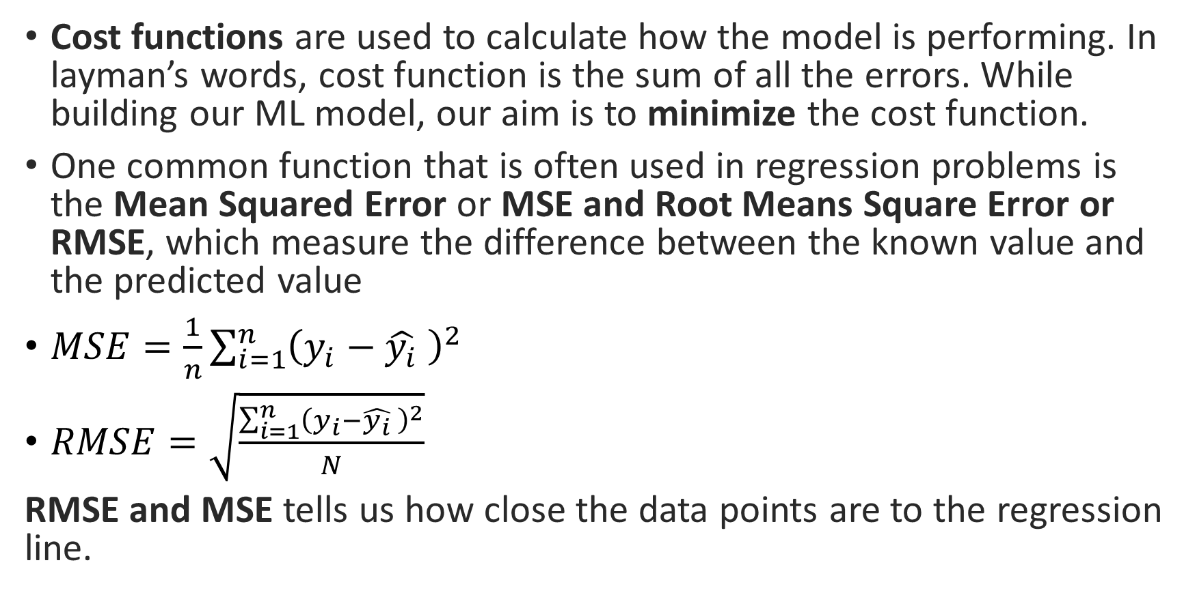
Cost Function
Cost functions are used to calculate how the model is performing. In layman’s words, cost function is the sum of all the errors. While building our ML model, our aim is to minimize the cost function.
One common function that is often used in regression problems is the Mean Squared Error or MSE and Root Means Square Error or RMSE, which measure the difference between the known value and the predicted value
$MSE=\frac{1}{n}\sum_{i=1}^{n}{{\left(y_{i}−\hat{y_{i}} \right)}^{2}}$
$RMSE=\sqrt{\frac{\sum_{i=1}^{n}{{\left(y_{i}−\hat{y_{i}} \right)}^{2}}}{N}}$
RMSE and MSE tells us how close the data points are to the regression line.

Slide 23
Gradient Descent
Gradient descent is an optimization algorithm used to find the values of parameters (coefficients) of a function (f) that minimizes a cost function (cost).
Gradient descent is best used when the parameters cannot be calculated analytically (e.g. using linear algebra) and must be searched for by an optimization algorithm.

Slide 24
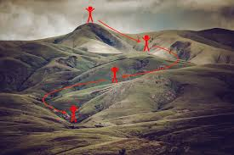
Philosophy of Gradient Descent
Gradient descent is an iterative optimization algorithm for finding the local minimum of a function.

Slide 25
Types of Gradient Descent
Logistic
Batch
Mini-Batch
Stochastic

Slide 26
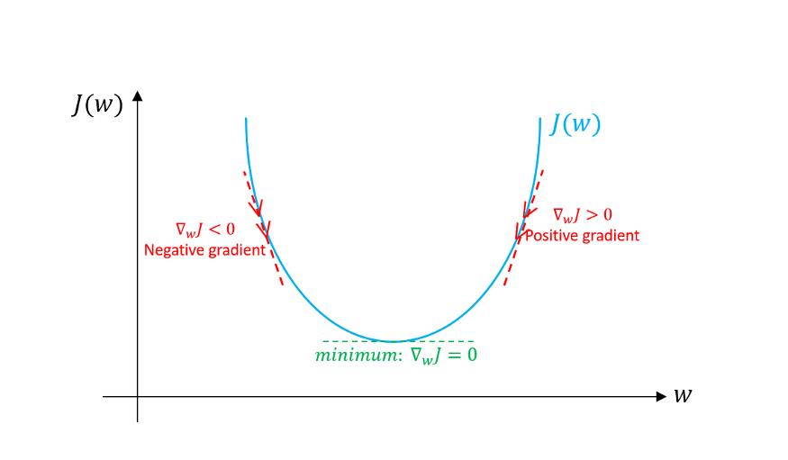
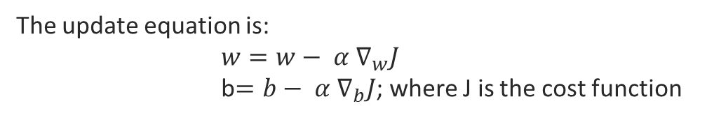
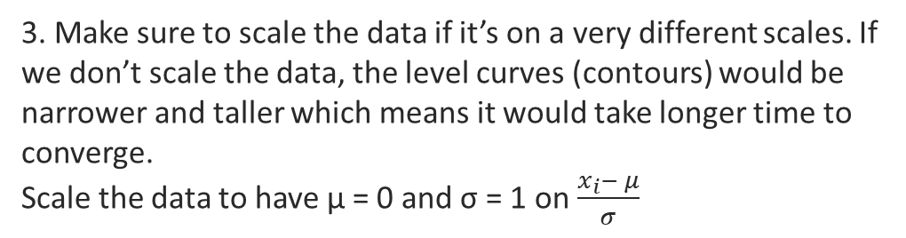
Logistic Gradient Descent
The update equation is:
$w=w− α ∇_{w}J$
b$=b− α ∇_{b}J$; where J is the cost function
1. Initialize weight w and bias b to any random numbers.
2. Pick a value for the learning rate α. The learning rate determines how big the step would be on each iteration.
If α is very small, it would take long time to converge and become computationally expensive.
If α is large, it may fail to converge and overshoot the minimum. Step 2 Diagram
For the sake of illustration, let’s assume we don’t have bias. If the slope of the current value of w > 0, this means that we are to the right of optimal w*. Therefore, the update will be negative, and will start getting close to the optimal values of w*. However, if it’s negative, the update will be positive and will increase the current values of w to converge to the optimal values of w*:
The most commonly used rates are : 0.001, 0.003, 0.01, 0.03, 0.1, 0.3.
3. Make sure to scale the data if it’s on a very different scales. If we don’t scale the data, the level curves (contours) would be narrower and taller which means it would take longer time to converge.
Scale the data to have μ = 0 and σ = 1 on $\frac{x_{i}− μ}{σ}$
Continue the process until the cost function converges. That is, until the error curve becomes flat and doesn’t change.
In addition, on each iteration, the step would be in the direction that gives the maximum change since it’s perpendicular to level curves at each step.
4. On Each Iteration take partial derivatives of the cost function
w.r.t weight (w) and bias (b).

Slide 27
Initial Cost
Step 4 Description
Step 2 Description

Slide 28
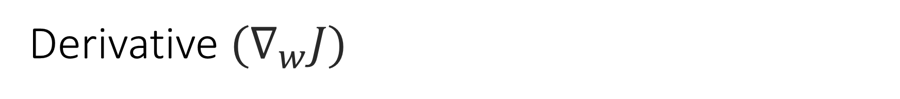
Derivative $(∇_{w}J)$
Machine learning uses derivatives in optimization problems.
Optimization algorithms like gradient descent use derivates to decide
whether to increase or decrease the weights to increase or decrease
any objective function.
If we are able to compute the derivative of a function,
we know in which direction to proceed to minimize it

Slide 29
Primarily focus on
Two Rules
Power Rule
Chain Rule

Slide 30
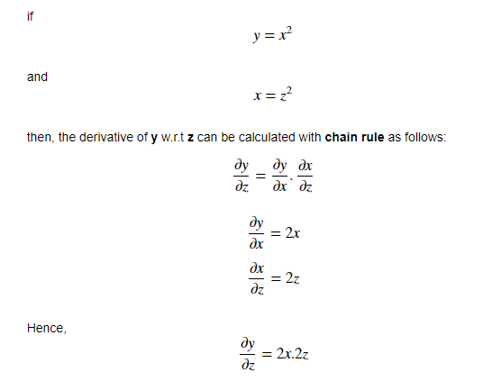

Chain Rule

Slide 31
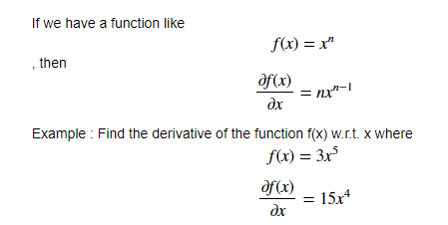
Power Rule

Slide 32

Thank you
Information System is a mapping between any elements of earth and Data where you apply imagination, experiment and observation to reveal the facts.
by Dr. Supriya Chakraborty

